Slide 1
Use complex techniques to develop a digital media outcome your name

Slide 2
Step 1 : Empathize

Slide 3
Task 1 : Identify your client and the purpose of your website, who is your target audience?
My client is the players of the game Call Of Duty Warzone/ myself
This means my target audience is later teens and older this means I have to focus on making an easy to use website for competent web users

Slide 4
Relevant Implication #1
My first relevant implication is usability this implication is very important because a website needs to be easy to use for it to be useful I will ensure I am following this implication by testing my web pages to make sure they are working smoothly. I will get feedback from others to see if the program is easy to use for someone who has never used it before with out instruction and I will change my website to suit their feedback
Notes:
Identify and explain 3 relevant implications that you will focus on during the creation of your project

Slide 5
Relevant Implication #2
My second relevant implication is aesthetics I will be focusing on the design/looks of my website this is a very important implication because if a website does not look go then people will not want to use it and will also likely find it hard to understand , in my website I will follow a simplistic look with no more than 3 colors to not over clutter my pages I will also use a large amount of images to split apart the text in my pages
Notes:
Identify and explain 3 relevant implications that you will focus on during the creation of your project

Slide 6
Relevant Implication #3
Copyright is a legal right, it is the laws that stop people copying other peoples work
To make sure I will follow this relevant implication I will make sure that I have used only not copyrighted photos/text so that I do not break any laws or restrictions with copyright such as I will make sure I have permission to use the schools photos and content. I already have a range of images that have been supplied by the school for my website this means I have full permission to use and edit them for my use. I get any content from the internet I will have to make sure that it is copyright free / the user has identified the content as something that I can use and edit for my own purposes
Notes:
Identify and explain 3 relevant implications that you will focus on during the creation of your project

Slide 7
What are your client’s specifications?
sophisticated digital effects (CSS3)
responsive design (mobile vs tablet vs desktop)
industry standards or guidelines for layout/design
integration of original media types (your own photographs/ videos etc)
coded using HTML5/CSS3 language
4 html pages and with an externally linked style sheet / js file for responsive navigation

Slide 8
Step 2 : Define

Slide 9
Website Structure
Website Site Map
index.html
interview.html
books.html
about.html

Slide 10
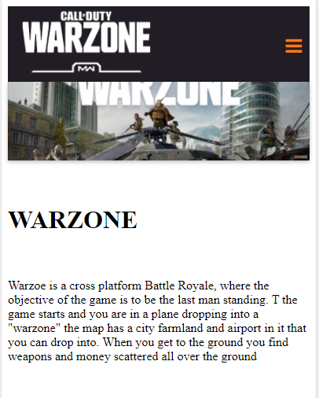
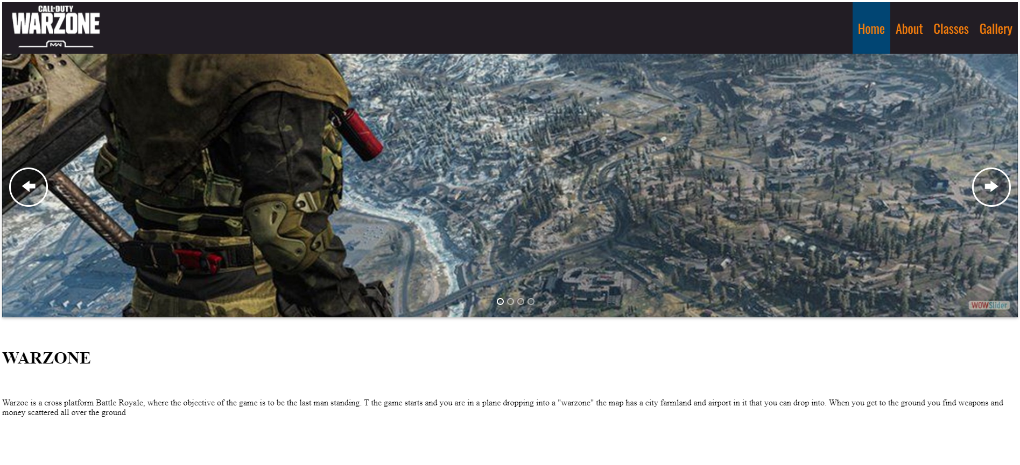
pogress
Feedback:
Get some higher res images that fit in the slider format nicer.
Get some Fonts on your body
Phone view looks divine
Proof read your content
Change the font of your body
Too much space between h1 an paragraph
I think you should start again, but use the same code because the scaling is very nice and works well.

Slide 11
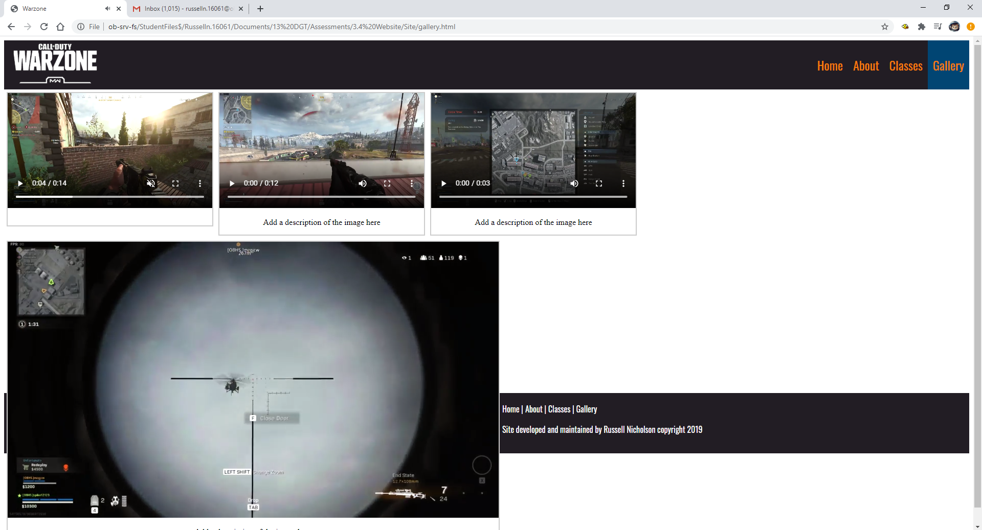
pogress
Feedback:
broken fix footer
Mimic the same padding from the footer to the the top nav bar. Add orange hover effect to the footer to tie into with the nav bar.
With your cards – have the h1 title larger.
Nice, easy to read font choice.
Put some spacing between each video so that they are evenly spaced out and not all on the left side of the screen.
Add a box shadow around the cards and make them even size

Slide 12
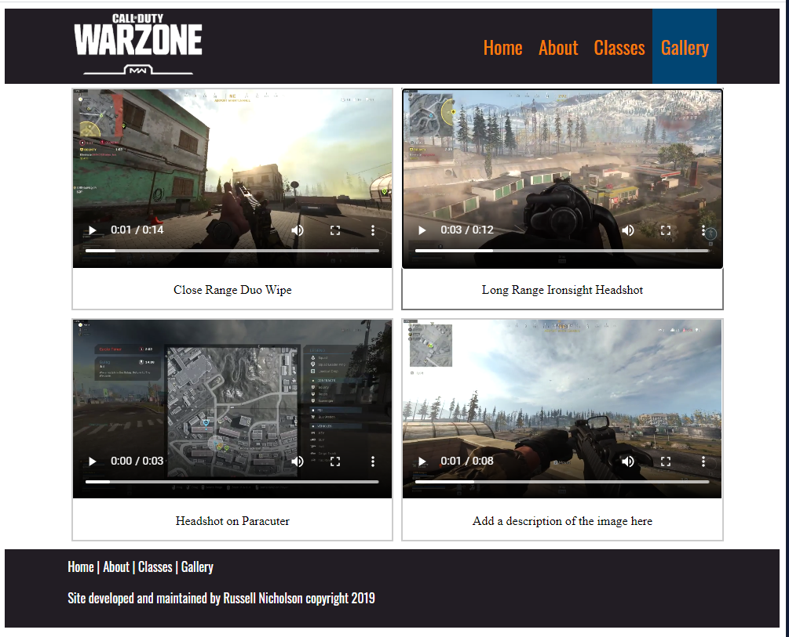
Feedback
Like the padding and sizing of images, maybe add some text to the page to describe that they are your clips or about that page.
Font on the clips label looks a bit boring
Add some padding to the top
Add a header saying what page I am viewing.

Slide 13
Data Integrity Gather content – proofread and edit
Notes:
Data integrity is ensuring the information displayed is up to date , spelled correctly . Do F7 on your word content.
Testing

Slide 14
Gather Content
Notes:
Save images to an appropriate name folder
Compress / edit images where need be
Name the files accurately e.g home_mainimage.jpeg suzanne_collins_closeup.jpeg rather than 249784sflkjfnjksfxn3r8.jpeg
Record this process

Slide 15
Step 3 : Ideate

Slide 16
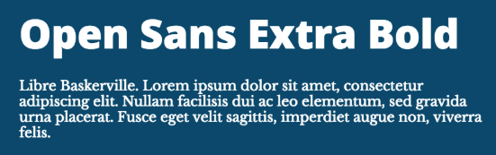
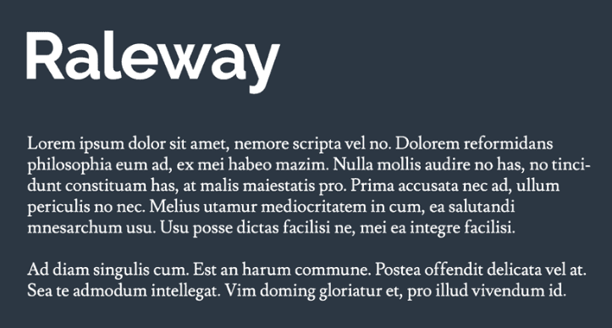
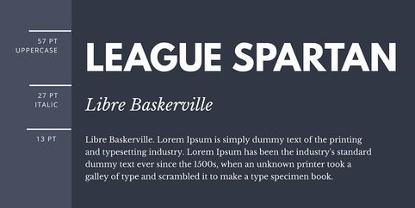
Font Combinations
Open Sans / Libre Baskerville
11
1
Raleway & Lusitana
1
1
11

Slide 17
Colour Combinations
1: 1111
1
2: 11
3: 11
1
1

Slide 18
Low fidelity wireframes
Notes:
Use either

Slide 19
A vs B testing - colours
Notes:
Give two layout options for the index page – eg placement of cotent . Get feedback from client

Slide 20
A vs B testing - fonts
Notes:
Give two layout options for the index page – eg placement of cotent . Get feedback from client

Slide 21
Feedback from client / stakeholders
Notes:
Get written feedback, then add your own reflections:
What changes do you need to make and why? Do you need to carry out further research or give more colour/font options etc/

Slide 22
Step 4 : Protype/ Testing

Slide 23
Site setup

Slide 24
Evidence of iterative improvement

Slide 25
Testing Scaling: Phone vs Tablet vs Desktop
Notes:
Test your site on mobile, tablet and pc view

Slide 26
Testing Procedures: Validating the HTML/CSS
Notes:
Validate your HTML/CSS3 website – screenshot the no errors.

Slide 27
Applying the UX (BASIC priniciples)to improve your design
Notes:
Identify which usability principles you have applied to improve the quality of your design – screenshot your design, place in your portfolio and annotate and explain how it improved the usability, aesthetics or functionality etc.

Slide 28
Explain how your final design addressed the relevant implications

Slide 29
Addressing relevant implication :

Slide 30
Addressing relevant implication :

Slide 31
Final website
Notes:
Create a video of your site in desktop view, slowly going through the content, scale it down to phone view too,. Insert the video above

Slide 32
Final feedback from client

Slide 33
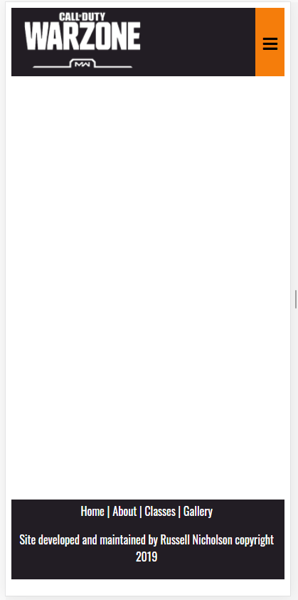
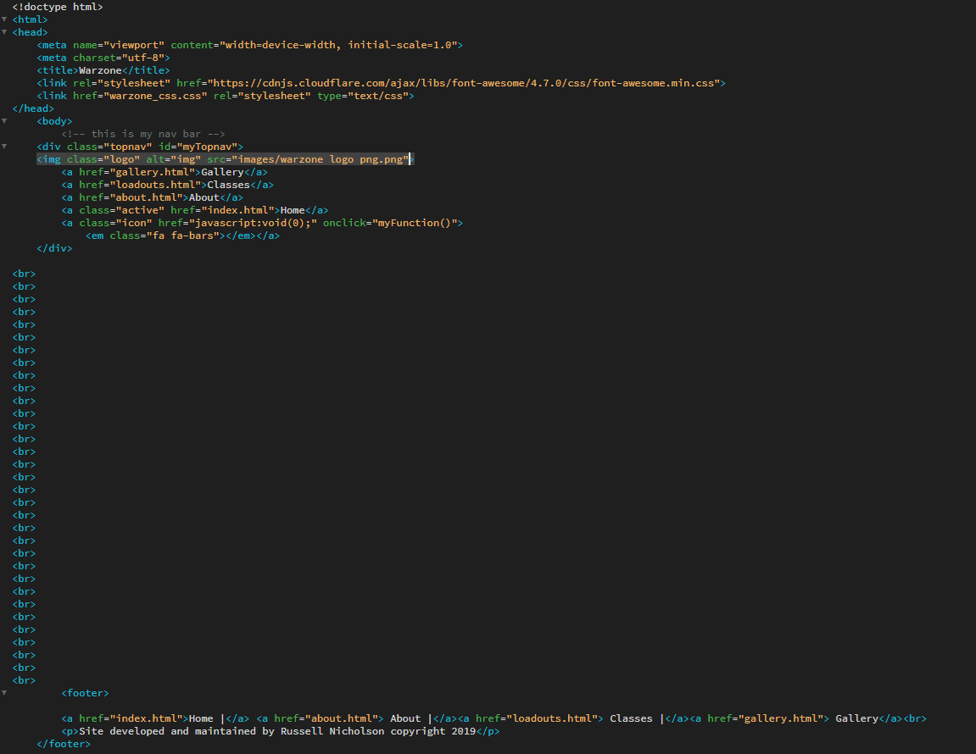
Progress

